Slide 1
What’s, Why & Careers at Splunk
~ Splunk Solved
94902 11937

Slide 2
What’s Splunk
Platform for searching, analyzing, and visualizing machine-generated data in real time.
Servers/VMs
Cloud
Network devices
Mobile devices/IOTs
Serverless (Containers/APIs/etc)
It helps businesses gain valuable insights into their operations, security, and customer behavior.
Provides centralized monitoring, troubleshooting, and investigating various data sources such as logs, events, metrics, and more.
Splunk Solved
94902 11937

Slide 3
Why Splunk
Versatility: Splunk can handle logs & metrics to structured and unstructured data
Real-time Insights: Splunk provides real-time visibility
Scalability: Splunk is highly scalable, capable of ingesting and analyzing massive data
Ease of Use: Splunk's user interface, powerful SPL, extensive documentation, and Apps & add-ons.
Security and Compliance: Splunk offers robust security features, encryption, auditing including role-based access control, SAML, LDAP, Duo/RSA Multi-factor capabilities
Machine Learning and AI: Splunk's built-in ML & AI can automate data analysis, detect anomalies, and predict
Community and Ecosystem: Splunk has a vibrant community of users, developers, and partners
Splunk's versatility, real-time insights, scalability, ease of use, advanced analytical capabilities, security features, and thriving community make it a great choice compared to other tools
Splunk Solved
94902 11937

Slide 4
Careers at Splunk
Cisco has recently acquired Splunk for approximately $28 billion on Mar’24
Splunk Admin, Splunk developer & Architect
The demand for Splunk skills is rapidly growing across industries.
Organizations are seeking professionals with Splunk expertise to drive Operations/Observability/Business/Security
Learning Splunk opens doors to exciting career opportunities in data analytics, cybersecurity, IT operations, and more.
Data Analyst, Business Intelligence Analyst, Data Scientist, IT Operations analyst
Security Analyst, SOC Analyst, Incident Responder, Security Engineer.
Splunk Solved
94902 11937

Slide 5
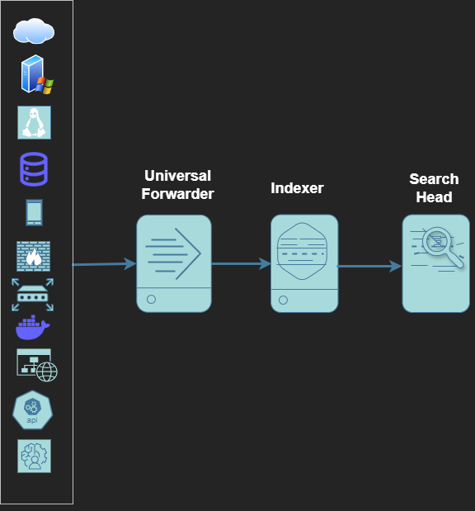
Splunk basic architecture
Splunk Solved
94902 11937

Slide 6
Salaries at Splunk (Indian)
Entry Level (0-2 years of experience): ₹4,50,000 - ₹6,50,000 PA
Mid-Level (2-5 years of experience): ₹6,50,000 - ₹12,00,000 PA
Experienced (5-10 years of experience): ₹12,00,000 - ₹20,00,000 PA
Senior Level (10+ years of experience): ₹20,00,000+ PA
Note: This is just an average taken as reference from few sites as of 2025
Splunk Solved
94902 11937

Slide 7
Splunk Admin Responsibilities
Capacity Planning
System Management
Data Ingestion and Parsing
User and Role Management
Performance Optimization
Security and Compliance
Monitoring and Alerts
Data Onboarding and Management
Backup and Recovery
Support and Troubleshooting
Splunk Solved
94902 11937

Slide 8
Splunk Developer Responsibilities
Data Onboarding and Parsing
Search Query Development
Dashboard and Visualization Creation
Alert and Report Development
Field Extraction and Data Normalization with REGEX
Advanced Search Processing Language (SPL) Scripting
Creating Knowledge Objects
Integration with External Systems
Application Development and Customization
Testing and Validation
Splunk Solved
94902 11937

Slide 9
Thank You!
Splunk Solved
94902 11937

